Slide 1
Notes:
In this presentation I will talk about the tactic of economic warfare, commonly referred to as “sanctions,” that the United States is using around the world. I will cover what sanctions are, who they impact and how they are related to the economic war being waged against the population at home. I will conclude with actions that can be taken to end this economic war.

Slide 2
Notes:
What are sanctions? Technically, they are commercial and financial penalties applied by one or more countries against another government, group or individual. They can include restrictions on trade as the United States has imposed on Iran, Cuba, North Korea, Syria, Zimbabwe and 14 other countries. These trade restrictions often prohibit other countries, including non-sanctioned countries, from also trading with the targeted country, a form of secondary sanction, or risk being sanctioned themselves.
Sanctions can take the form of blocked financial transactions, not allowing financial institutions to process them. This prevents a government, group or individual from doing business - buying goods or services outside the country. A government can also freeze the assets of another country or entity as the United States did to Venezuela via executive order in August 2019 that read “All property and interests in property of the Government of Venezuela that are in the United States ... are blocked and may not be transferred, paid, exported, withdrawn, or otherwise dealt in.”
A government can sanction by reducing foreign aid that is typically given as the US did to Palestine or it can block loans through US-dominated institutions such as the International Monetary Fund or World Bank.

Slide 3
Notes:
The idea of using economic sanctions against another country has been sold to the public in the United States as a more humane tactic than military invasion.This is false..
Like other forms of warfare, sanctions are used to give the US an economic advantage over other countries. An example is US sanctions that target Chinese technology firms such as Huawei.
Most often the US uses sanctions as a tool to overthrow governments it doesn’t support. The goal is to impose economic hardship on a country (“make the economy scream”), claim the government of that country is responsible for the hardship and encourage the population to rise up in protest against its government. The manufactured, and often US-supported, opposition is used to justify more US intervention to demand the government step down or a coup may be conducted.
Sanctions are also used as retaliation to undermine the efforts of countries to move towards more independence or develop non-capitalist economies. Sanctions were imposed on members of the International Criminal Court for proceeding with an investigation of the US’ war crimes in Afghanistan.

Slide 4
Notes:
Sanctions are war. They are just as deadly as bullets and bombs, but the damage and deaths are not as visible to those outside the country.
Sanctions kill by destroying economies, causing hyperinflation and unemployment so people cannot afford basic necessities. They drive capital flight from countries as corporations and financial institutions seek to distance themselves and avoid being targeted by the sanctions. As industries move elsewhere or can’t get the materials they need, jobs are lost. Basic infrastructure may be harmed as funds and expertise are lost. They prevent countries within the region from working together or trading. And even if the country has the funds to purchase basic goods, they are blocked from making financial transactions or importing them. One study found sanctions contributed to 40,000 deaths in Venezuela between 2017 and 2018. Another study found sanctions contributed to the deaths of 4,000 North Koreans in 2018, most of them children and pregnant women. In the early 1990’s, US sanctions against Iraq led to the deaths of as many as 880,000 children under five due to malnutrition and disease.

Slide 5
Notes:
The sanctions imposed by the United States violate international laws and the United States Constitution.
Technically, the sanctions imposed by the US are not sanctions but are unilateral coercive measures. Sanctions imply there was a legal process employed that found a country, group or individual in violation of a law and that entity was then punished using sanctions.
What the United States is doing mostly operates outside that process. The economic war is applied unilaterally. When the United States does use a legal process, such as through the United Nations, the US applies pressure on other countries to achieve its desired result.
Some impacted countries are starting to challenge the unilateral coercive measures in court. In October, 2018, Iran won a case against the United States in the United Nations’ International Court of Justice over the US imposed sanctions but the US refused to comply with the ruling. The ICJ does not have an enforcement mechanism. Currently, Venezuela has a case before the International Criminal Court charging the US with crimes against humanity for the suffering and death its coercive measures have caused.
The Supremacy Clause of the US Constitution declares that international laws are to be considered equal to an act of legislature, although limits have been placed on this since its inception.

Slide 6
Notes:
A first step in the sanctions process is often that the White House declares a country as a threat to US national security or designates a foreign entity as a terrorist group. There is usually no evidence to back this claim or evidence is manufactured. This triggers the International Emergency Economic Powers Act that allows the US Treasury to impose economic sanctions.
Congress and the State Department can also impose sanctions on countries, such as the recent NICA Act targeting Nicaragua, or individuals, such as travel bans that prevent United Nations diplomats from participating in UN meetings.
The United Nations Security Council has the authority to impose sanctions on countries or specific entities. The United States, as a permanent member of the UN Security Council, wields tremendous power over the UN sanctions process. That power may be starting to wane. In 2020, the US attempted to extend a weapons embargo against Iran but the members of the UN Security Council voted overwhelmingly against it, arguing the US lost its standing when it pulled out of the Iran Nuclear Agreement.

Slide 7
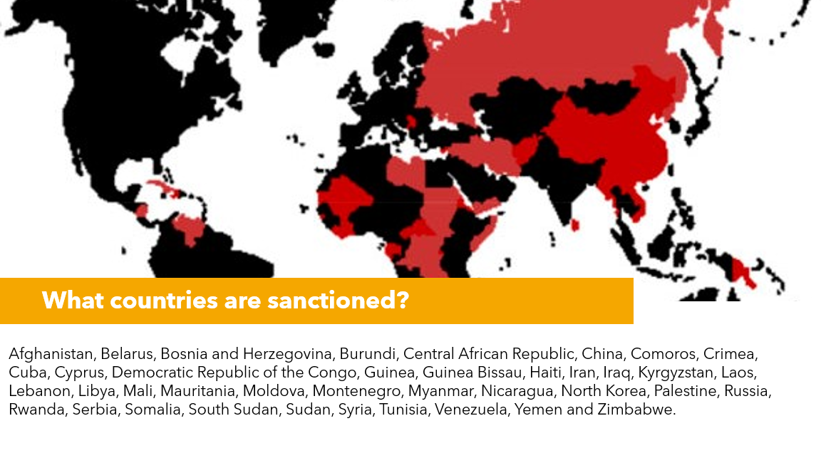
Notes:
The United States is currently sanctioning 39 countries representing one-third of the global population. As the list under the map demonstrates, a third of the countries are African nations. The majority of sanctioned countries are predominantly non-white and are in the Global South. In addition to countries, over 6,300 people are on the Treasury Department’s Office of Foreign Assets sanctioned list.
To get the sanctions lifted, countries must agree to the United State’s demands for austerity measures, elections that meet the US’ approval and other economic and political concessions. This is why the sanctions are actually unilateral coercive economic measures, which are illegal.

Slide 8
Notes:
While the United States government says that sanctions exempt necessities such as food and medicine and often claims the sanctions impact government or other officials, the reality is that it is the civilian population, especially women, children, the elderly and those who have health conditions, who are impacted the most.
As I will outline in more detail, sanctions weaken economies, cause unemployment and inflation, prevent the import of necessities such as food, medicines and equipment to keep infrastructure and industries running and prevent trade and travel.

Slide 9
Notes:
Perhaps one of the most egregious effects of unilateral coercive measures or sanctions are on the health of the population. Even when countries have the funds to purchase medications, they are unable to make the financial transaction to pay for them. Venezuela has $1 billion worth of gold in the Bank of London that it intends to use to purchase necessities through the United Nations, but the UK is refusing to release it. Similarly, Venezuela had a fund through its oil company Citgo that it was using to pay for its bone marrow transplant patients, primarily children, in Spain, but the United States seized Citgo. And the Venezuelan pharmaceutical industry, which was once thriving, has been decimated because Venezuela can’t import the precursors it needs to manufacture medications.
Additionally, sanctioned countries are unable to import medical supplies and equipment. They are forced to reuse single-use supplies. They have shortages of fuel which prevent the transport of patients and basic infrastructure that provides power and water may not function well. Shortages of food, water and power impact the general health of the population. We know for example that more children die of infectious diseases, especially diarrheal disease, when they lack access to clean water.
And finally, sanctioned countries have more barriers to research. Their scientists can’t purchase scientific books from abroad or travel to conferences. They can’t collaborate with institutions in other countries. In reality, sanctions imposed on other countries impact the health of people in the United States because we don’t have access to the medical innovations developed in sanctioned countries and we can’t benefit from medical collaboration. For example, Cuba sends doctors around the world to provide care and support for healthcare systems.

Slide 10
Notes:
Another egregious impact of sanctions is a shortage of food. The most obvious reason is the inability to import food because banks won’t process the financial transactions, but even if a sanctioned country makes the transaction, the food can’t be transported because insurance companies won’t cover the vessels that would carry it.
Sanctions also harm agricultural institutions. There are shortages of seeds and inputs for farming as well as fuel to run farm machinery and transport food. In Zimbabwe, it was when the people took action to reclaim their land, which had been promised to them, that the US imposed damaging sanctions on them.
Food shortages and the economic devastation from sanctions that creates hyperinflation raises the price of food while at the same time unemployment rises making it difficult for families to have adequate food. Most of the food insecure nations in the world are sanctioned countries.

Slide 11
Notes:
Water is also essential for life and sanctions have a negative impact on access to clean water resulting in hardship and disease.
The major reasons sanctions prevent access to clean water are the inability of a country to import parts to keep its water infrastructure operating and shortages of fuel to power the infrastructure such as water and sewage treatment plants and pumps to deliver water into homes and other buildings.

Slide 12
Notes:
Sanctions impact education at every level from the lack of resources to keep schools open and operating to the inability to import basic school supplies such as pencils and books. Students are blocked from using online tools and computer software if they live in a sanctioned country because corporations do not want to risk penalties for potentially violating the sanctions.
Sanctions can also prevent students from attending school. They may not be allowed to study abroad, or even if they are accepted for study abroad, they are unable to pay for the education because banks won’t process the transactions. The economic hardship and food shortages caused by sanctions may cause children to leave school to work or help with food production.

Slide 13
Notes:
Sanctions prevent the importation of fuel and parts to run power plants as well as the importation of power from neighboring countries. Sanctions also decrease access to parts to maintain the electrical grid.
Even in countries with large fossil fuel resources such as Venezuela and Iran, sanctions prevent them from importing the materials and equipment necessary to keep their drilling and refinery equipment in order so they can use the fossil fuels.

Slide 14
Notes:
Reduced access to oil and gas impacts the entire transportation infrastructure of sanctioned countries. So does the inability to import parts and tools to keep cars, trucks, buses and trains running.
In Cuba, cars are kept running for many decades using whatever is available and cars are passed down through families. In Venezuela, due to the fuel shortage, people may wait for days in line to fill their car with gas.
The negative impact of sanctions on transportation have a broad effect on the ability to move people and goods around the country, which ripples out to impact farmers, manufacturers, and businesses.

Slide 15
Notes:
Sanctions worsen unemployment in targeted countries through a variety of mechanisms. Even during the pre-sanction period, when a country is designated a national security threat, investors and corporations see what is to come and may leave the country. This capital flight causes a loss of jobs.
Hyperinflation makes the price of goods rise and decreases people’s ability to purchase them, which may cause businesses to go bankrupt and shut down.
Lack of investment capital as well as the inability to import needed supplies and equipment leads industries to weaken or shut down altogether, also causing a loss of jobs.
Barriers to trade with other countries means producers of food and other goods have a smaller market to sell to, which adversely impacts them. And finally, the effects of sanctions on transportation may mean that producers cannot get their goods to the market, if it exists.

Slide 16
Notes:
Sanctions create real hardship for people and may drive them to leave their home country.
When an economy is destroyed and people can’t meet their basic needs, or unemployment is high or there is violence as a result of unrest, people often feel they have no choice but to emigrate. This can lead to a “brain drain” as those who have financial resources, and perhaps are educated in professions such as medicine or engineering, are likely to leave. This compounds the hardship as there are fewer people to tend to provide the needed expertise to keep the country functioning.

Slide 17
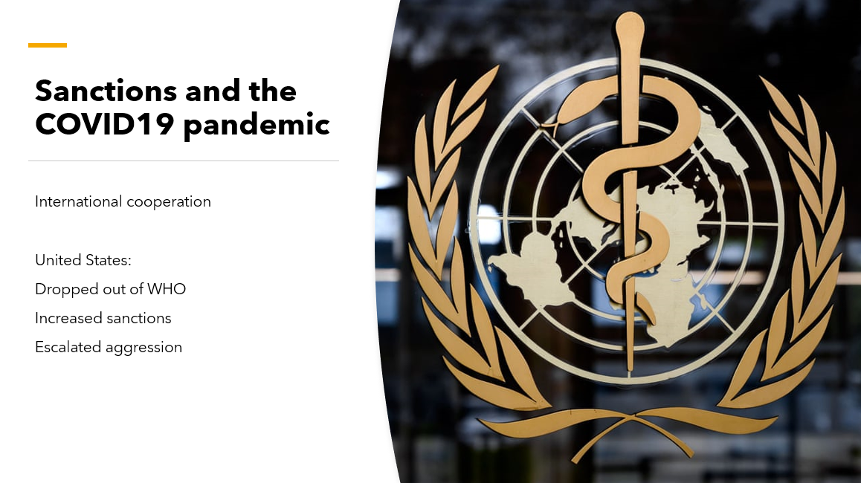
Notes:
In the spring of 2020, the COVID-19 pandemic led to a global call for peace and international cooperation to stop the spread of disease and ensure nations had what they needed to protect the health of their people.
There were calls from international bodies such as the United Nations to end sanctions because of their impacts on food and health. The United States rejected this call for cooperation and instead dropped out of the World Health Organization, increased sanctions against countries such as Iran and Venezuela and continued its military aggression.
The United States also failed to provide the basics for its own people during the pandemic. It should be no surprise that a government that has no regard for the lives of people abroad would show the same disregard for its own population.

Slide 18
Notes:
There are numerous ways the unilateral coercive measures imposed by the United States on countries around the world harm people in the US.
An obvious one is the restrictions on trade that prevent businesses in the US from doing business with these countries. For example, US farmers cannot export their products to sanctioned countries. They also prevent imports from sanctioned countries.
In an effort for other countries to circumvent the sanctions, they are finding new ways to do business that exclude US dollars and exclude financial institutions that are constrained by the US. This is leading to isolation of the US and de-dollarization.
Economic warfare against other countries may destabilize them, leading to violence and threats to global security. In some places, the economic measures create greater solidarity within the impacted country as the people unite to oppose a common enemy, the United States.
Restrictions on the sharing of information and collaboration with entities in other countries stifles innovation and prevents people in the US from benefiting from new technology in sanctioned countries.
Economic warfare drives migration as people seek employment and escape from instability and violence. The blame for migration is often put on the person who is migrating instead of the circumstances that forced them to flee their home country.
In the United States, migrants are often falsely blamed for the economic insecurity that people in the US experience. They become a handy scapegoat that divides the working class against each other instead of uniting against a common cause of the insecurity - an economic system that serves the wealthy and a foreign policy of domination.

Slide 19
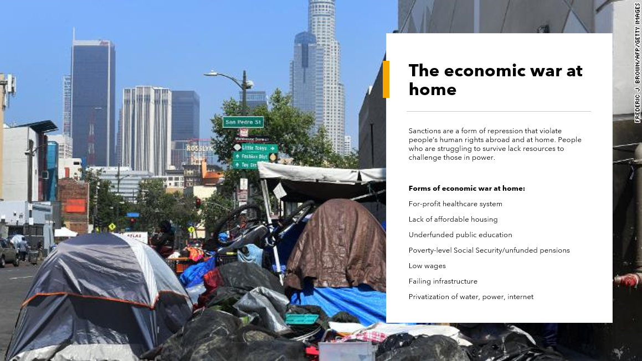
Notes:
The economic war that people experience in the United States is similar to what people experience in sanctioned countries. The same neoliberal economic policies that the US imposes on countries around the world are imposed on people within the US.
These take the form of a for-profit healthcare system that leaves tens of millions of people in the US without health insurance and tens of millions of people who are underinsured, meaning that despite having health insurance they still cannot afford the care they need. The United States has a severe lack of affordable housing. Public education is underfunded and higher education is not available to all who seek it. Wages are low and most people do not have a secure retirement. Infrastructure in the US is failing due to a lack of investment in its upkeep, and this is being used as an excuse to privatize everything from public housing to the postal service to water, the internet, schools, roads, public transport, etc.
As one of the wealthiest nations in the world, the United States can afford to provide these services to its people, and indeed the government has an obligation to provide these services that it is failing to meet. It is the same ideology that drives the economic war abroad and at home. The answer is a People(s) -Centered Human Rights approach that is rooted in the self-determination of communities and struggle against the power holders who value profits over human life and a livable future.

Slide 20
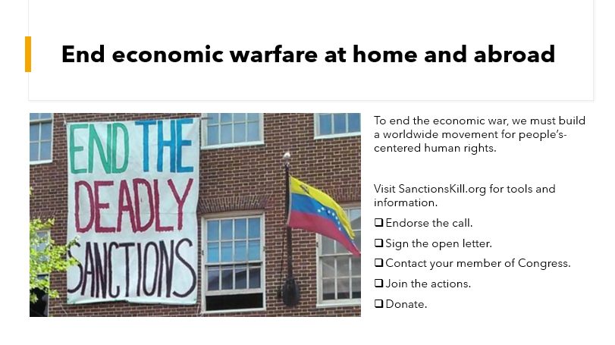
Notes:
It is time for people around the world to unite and demand an end to the economic wars being waged at home and abroad.
Join the Sanctions Kill campaign at SanctionsKill.org. You’ll find resources and actions that you can take.
Endorse the call to action, which will add you to the email list so you can be notified of opportunities for action and education.

